Slide 1
Breedlove ANN in Excel

Slide 2
Purpose
To show the computations of a node/unit in an Artificial Neural Network (ANN, NN)
Input function
Activation function
Sigmoid
Linear
There are several non-standard or non-best practices in this example.
Normally, we will scale input variables to [0, 1]
Consequently, weights and inputs can be any real number
Solver is NOT the same as backpropagation

Slide 3
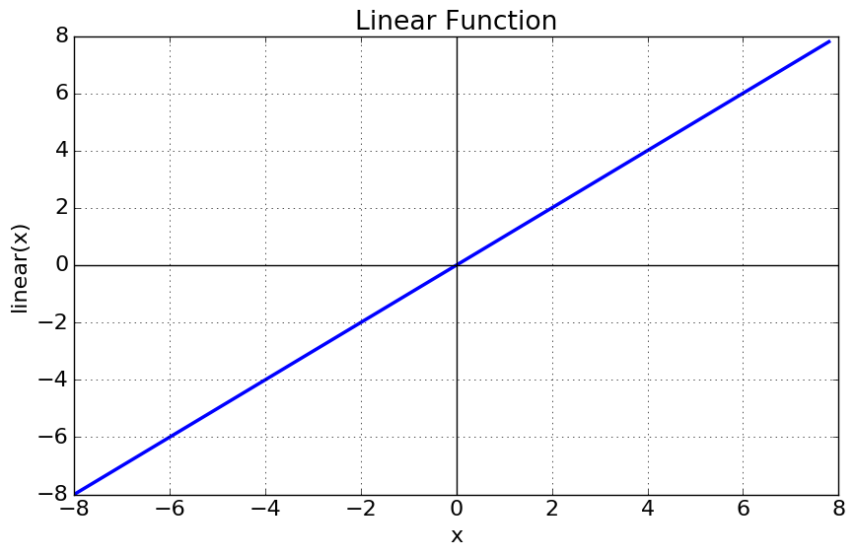
Linear Activation Function

Slide 4
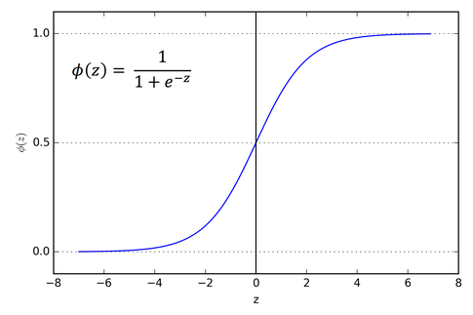
Sigmoid Activation Function

